Slide 1
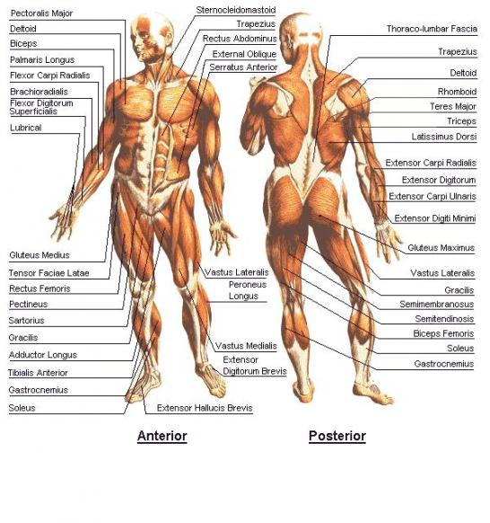
Assignment 1 continued……………..P3/P4/M1/D1 The muscular system
Location of the major muscles in the human body.
Function of the muscular system and the different fibre types.

Slide 2
Tasks______
Identify the location of the major muscles in the human body P3
Muscular system: major muscles (biceps, triceps, deltoids, pectoralis major, rectus abdominis, rectus
femoris, vastus lateralis, vastus medialis, vastus intermedius, semimembranosus, semitendinosus, biceps femoris, gastrocnemius, soleus, tibialis anterior, erector spinae, teres major, trapezius, latissimus dorsi, obliques, gluteus maximus);
function; location; types of muscle (cardiac, skeletal, smooth)
Describe the function of the muscular system and the different muscle types. P4
Further explain (M1) and analyse (D1) the function of the muscular system and the different muscle types. M1, D1
Function of the muscular system: movement – antagonistic pairs (agonist, antagonist); fixator; synergist; types of contraction (isometric, concentric, eccentric, isokinetic)
Fibre types: Type 1; Type 2a; Type 2b; characteristics; types of sports each are associated with

Slide 3
Assessment breakdown
To gain P3 you must IDENTIFY the major muscles in the body. This can be done via a labelled diagram and supported by a table stating their function and location. You will also need to describe the types of muscles in the body.
To gain P4/M2/D1 you need to describe/explain/analyse (D/E/A) the function of the MS and D/E/A the different fibre types. This is more detailed and it would be wise to use examples of sporting movements when doing so. A combination of tables and annotated pictures can and should be used to gain the full distinction for this assignment. Please refer to the previous slide when D/E/A all functions and types of muscle fibres

Slide 4
Verb definitions
Describe – when you are asked to describe you should try and paint a picture in words to the reader. It is useful to always think that the reader of your script knows nothing and therefore you have to teach the reader the knowledge that you have through your assignment.
Explain – when you are asked to explain you should describe the point and then give details and reason of why. This should include actual examples to back up your description.
E.g. if you are describing sporting injuries to explain the injury you would provide an example from the world of sport of an athlete who has had the injury and explain the causes of this injury to the player, you may also explain the treatment to the player.
Analyse – when you are asked to analyse you should select the key points that you have been asked to look at and explain each point providing reasons for each point and possible impacts.
e.g. if you where analysing the recent success of Chelsea Football Club. You would pick out the key factors behind Chelsea’s success; Money; Manager; Key Players – Frank Lampard, etc etc. you would then explain the contribution each person has had on the success on the club and what the club could do in the future to continue their reign.

Slide 5
Resources
www.brianmac.co.uk
www.sport-fitness-advisor.com
www.teachpe.com
www.righthealth.com
www.human-body-facts.com
www.innerbody.com

