Slide 1
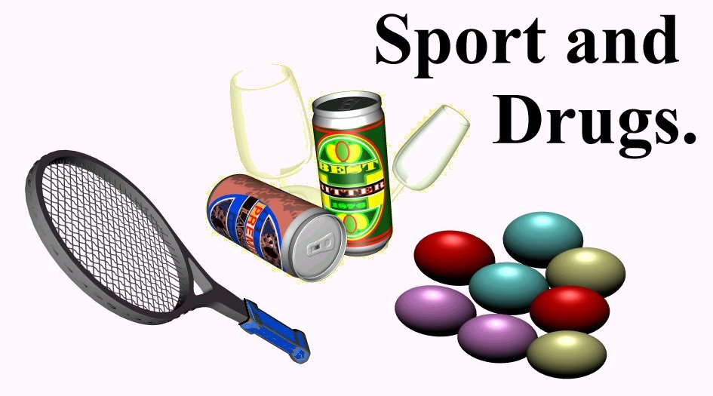
AIMS:
TO UNDERSTAND WHY PERFORMERS TAKE PERFORMANCE ENHANCING DRUGS.
TO KNOW THE REASONS WHY PERFORMERS SHOULD NOT TAKE DRUGS.
BE ABLE TO RELATE THEORY TO A SPORTING EXAMPLE.

Slide 2
Drugs in sport.
With the people next to you, list all the drugs you know exist in sport, both legal and illegal.

Slide 3
THE OLYMPIC OATH
“IN THE NAME OF ALL COMPETITIORS, I PROMISE THAT WE SHALL TAKE PART IN THESE OLYMPIC GAMES….WITHOUT DOPING AND WITHOUT DRUGS IN THE TRUE SPIRIT OF SPORTSMANSHIP”.
(IOC, SEPT, 2000)

Slide 4
Why do they do it?
Why shouldn’t they do it?
How can it be stopped?

Slide 5
WHY DO PERFORMERS TAKE DRUGS?
PHYSIOLOGICAL REASONS: build muscle, increase energy and O2 transport, lose weight, train harder, reduce tiredness.
PSYCHOLOGICAL REASONS: steady nerves, increase aggression and motivation.
SOCIAL REASONS: pressure to win, earn money from success, fear of losing, ‘win-at-all-costs’, belief that everyone else is doing it.

Slide 6
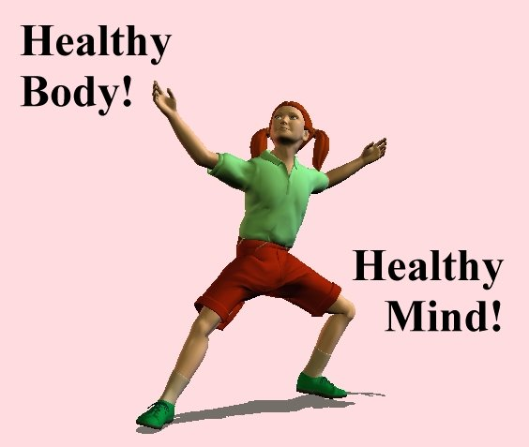
THE REASONS FOR NOT TAKING DRUGS
MORAL REASONS: unfair advantage, undermines true spirit of sport, reflects badly on others.
HEALTH REASONS: addictive, lower life expectancy, liver disorders and heart disease, mood swings and aggression.
LEGAL REASONS.
ROLE MODELLING: bad example to others, gives a bad image of the sport.

Slide 7
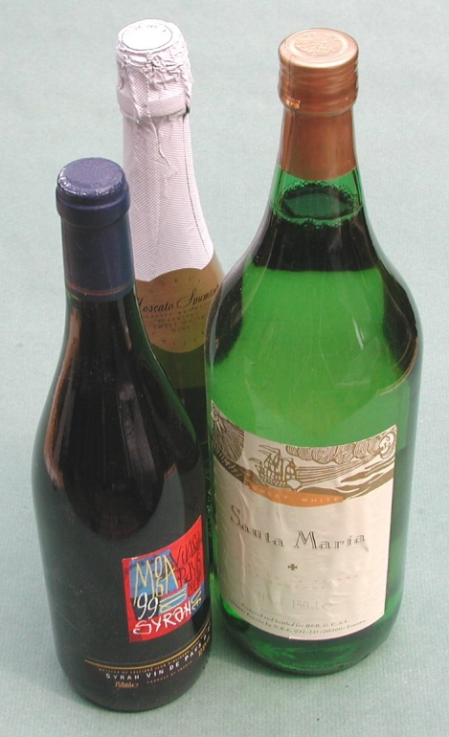
HOW CAN WE SOLVE THE PROBLEM?
STRICTER TESTING.
EDUCATION PROGRAMMES FOR ATHLETES AND COACHES.
MORE MONEY FOR TESTING PROGRAMMES.
WORLD WIDE ANTI-DOPING POLICIES.
MORE POSITVE ROLE MODELS AGAINST DRUGS IN SPORT.

Slide 8
EXAM QUESTION.
SPORT CANNOT JUSTIFY A DRUG CULTURE.
EXPLAIN THIS IN THE CONTEXT OF CHEATING, RISK TO HEALTH AND ROLE MODELLING. [5 MARKS]
CHEATING.
RISK TO HEALTH.
ROLE MODELLING.

