Slide 1
Unit 1
Principles of anatomy and physiology in sport

Slide 2
Bones of the human skeleton

Slide 3
The axial skeleton: (a) the skull, (b) the thorax and (c) the vertebral column

Slide 4
The appendicular skeleton: (a) the upper limbs, (b) the lower limbs, (c) the shoulder girdle and (d) the pelvis

Slide 5
Main anatomical terms

Slide 6
Long bones include the bones of the lower limbs, such as the femur, tibia and fibula

Slide 7
The carpals of the hand are examples of short bones

Slide 8
The sternum is an example of a flat bone

Slide 9
The vertebrae of the spine are examples of irregular bones

Slide 10
Anatomical positions

Slide 11
Fixed joints in the cranium

Slide 12
A slightly movable joint in the vertebral column

Slide 13
A synovial joint in the knee

Slide 14
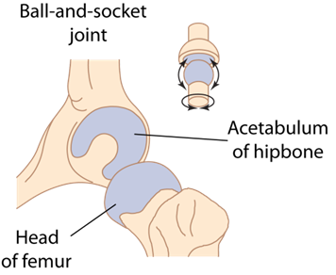
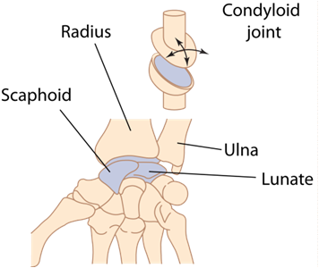
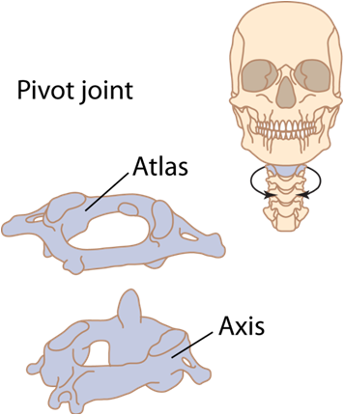
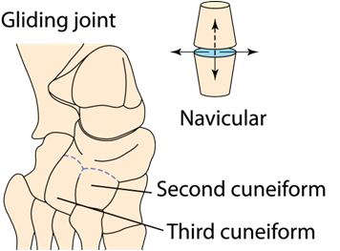
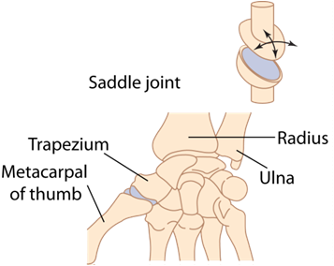
Types of synovial joint

Slide 15
Anatomical and biomechanical terms relating to muscle action

Slide 16
(a) Anterior muscular system and (b) posterior muscular system

Slide 17
Major muscles and their functions

Slide 18
Major muscles and their functions (continued)

Slide 19
Riding a bike involves a complex series of muscular movements

Slide 20
The rings in men’s gymnastics demonstrate many isometric contractions

Slide 21
In a concentric contraction the muscle shortens

Slide 22
Characteristics of each muscle fibre type and sports associated with each fibre type

Slide 23
The heart

Slide 24
Double circulation of blood through the heart

Slide 25
Major blood vessels

Slide 26
Structure of an artery

Slide 27
The capillary system

Slide 28
Structure of a vein

Slide 29
How is blood carried around your body?

Slide 30
Cross-section through the thorax to show the respiratory organs

Slide 31
The lobes and pleural membranes of the lungs

Slide 32
Gaseous exchange in the alveoli

Slide 33
Lung volume and capacities of a healthy adult

Slide 34
ATP and energy released from the breakdown of ATP

Slide 35
Energy systems used for different sports

