Slide 1
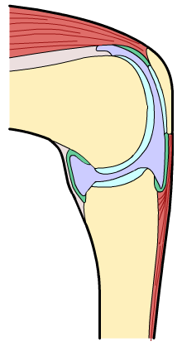
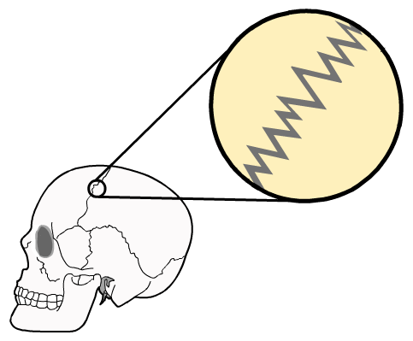
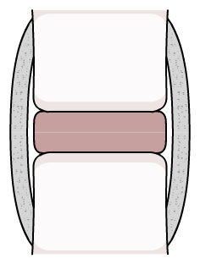
UNIT 1: Principles of Anatomy…
P2: Describe the different classifications of joints
Bone
Cartilage
Bone
Fixed
Slightly movable
Freely movable

Slide 2
Tasks
Create tables for the 3 different joint classifications that incorporates a description of;
their type/s
structure (use diagrams where necessary)
movement that occurs (relate each movement to a sporting action)

